Slide 1
COS20031
Computing Technology Design Project
Week 04: Design Thinking, Requirements and Modelling Entities and Relationship

Slide 2
TABLE OF CONTENTS
Design Thinking
(B) Gathering Requirements
(C) Developing the Conceptual Data Model

Slide 3
Database Development Lifecycle
Planning
Requirement gathering
Conceptual design
Logical design
Physical design
Construction
Implementation and rollout
Ongoing support

Slide 4
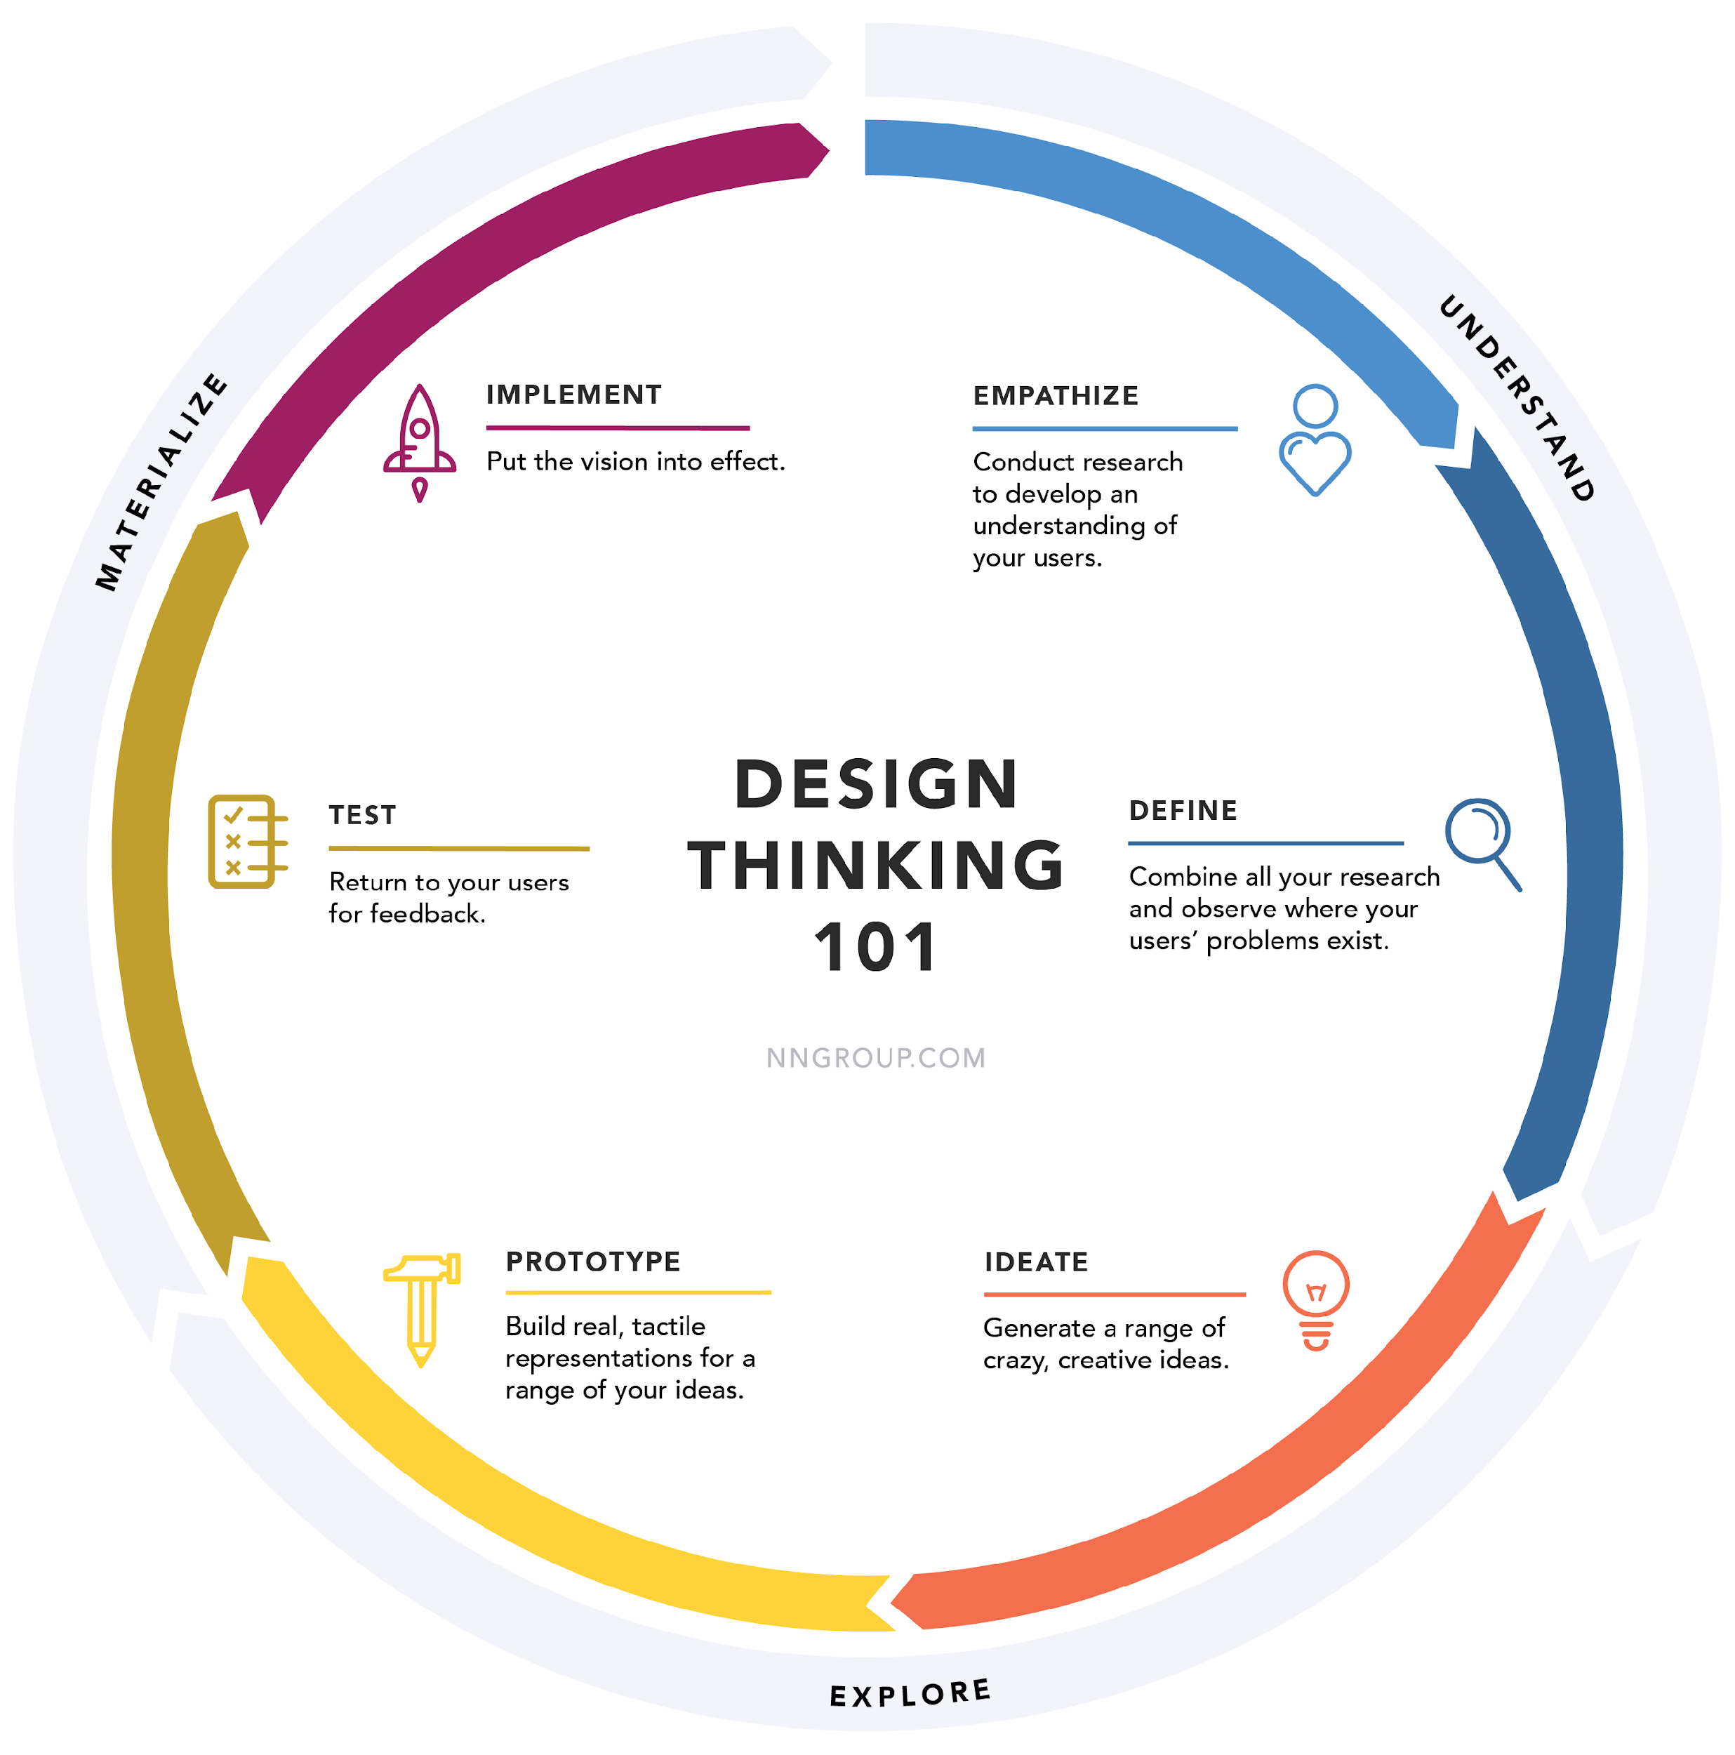
Design Thinking

Slide 5
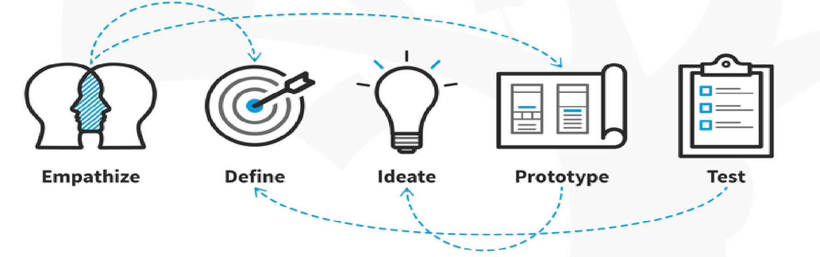
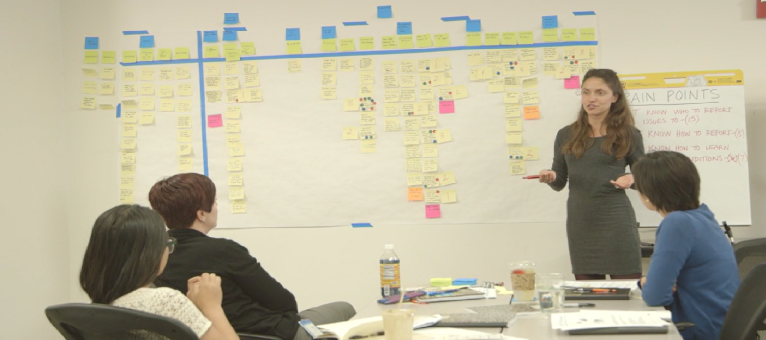
What is Design Thinking?

Slide 6
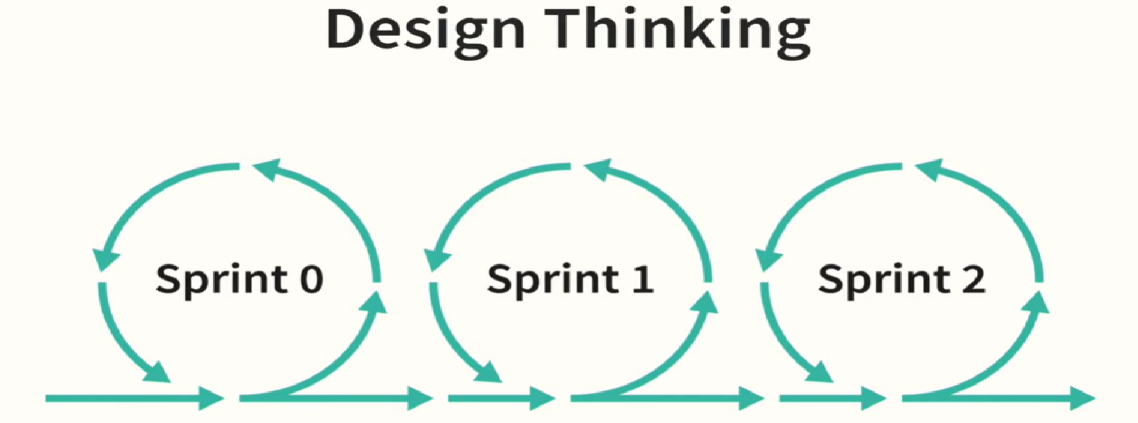
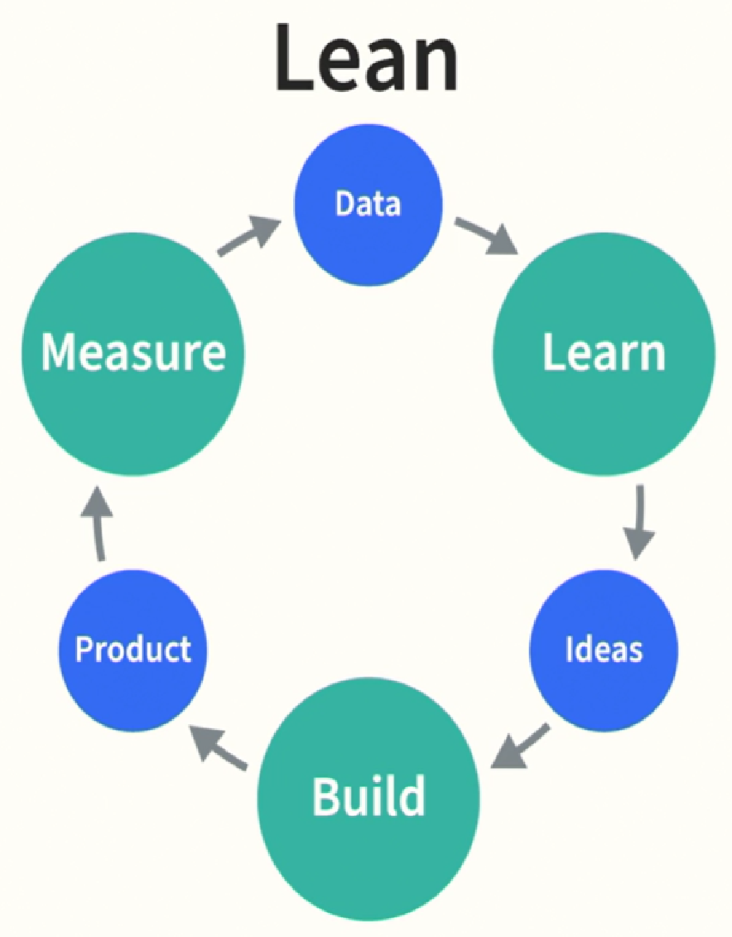
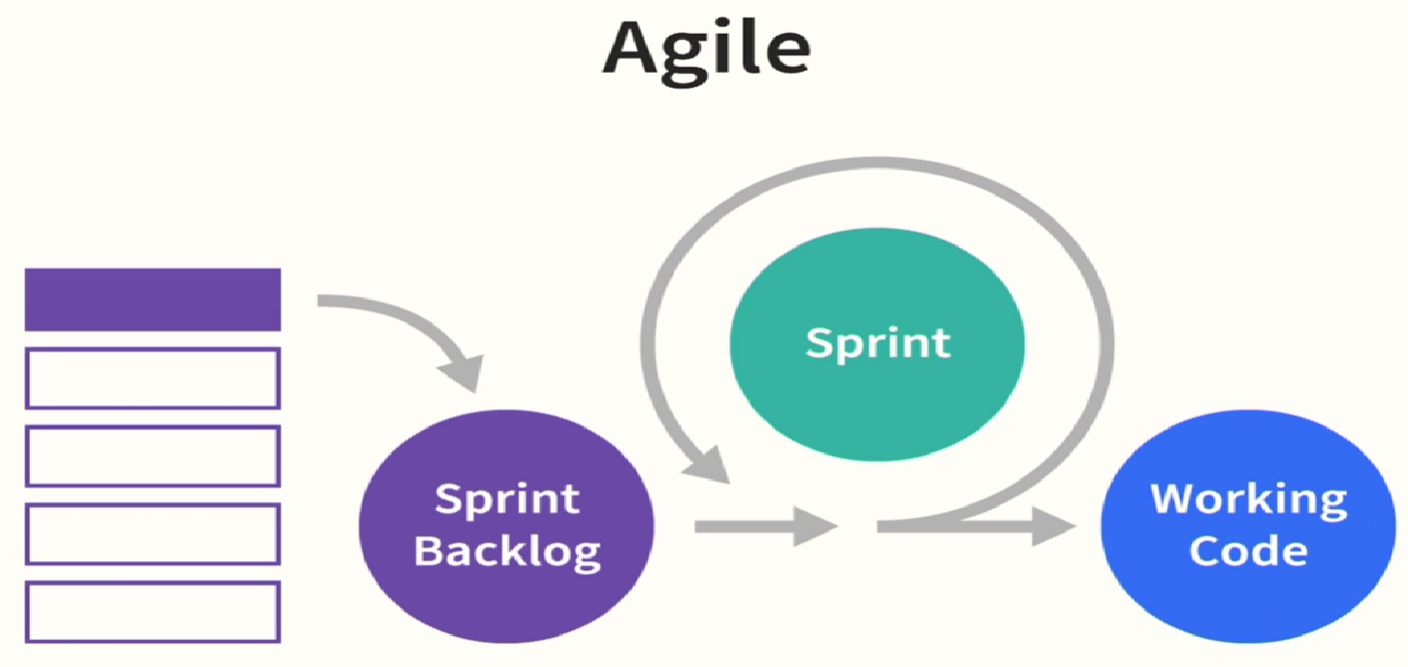
Agile, lean and design thinking

Slide 7
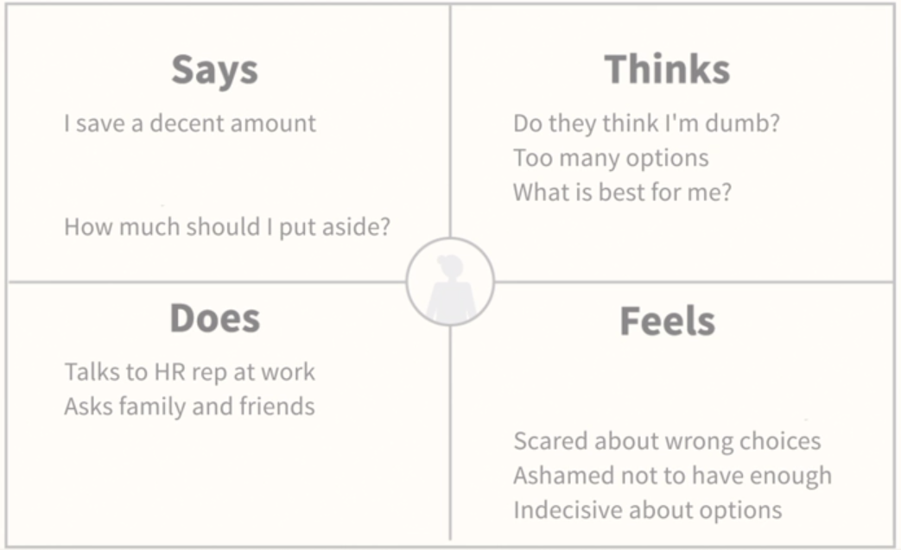
Empathy
Empathy: to understand deeply your users
Persona: archetypal representation of a user type, describing roles, motivations, goals, behaviours and desired outcomes
behaviour: pain points or work arounds
Empathy map: tool to quickly summarise user(s) for understanding, used
for cross-functional teams (UI/UX, product, dev)
in planning, brainstorming, design discussions
updated throughout the project
Empathy map: Saving for retirement

Slide 8
Empathy Mapping: The First Step in Design Thinking
Empathy map: a visual representation of user attitudes and behaviors (not chronological or sequential). It helps to:
align on a deep understanding of end users
spot trends, see patterns (incl. pain points or gaps)
Format: split into 4 quadrants (with the persona in the middle)
Says: taken from user quotes
Thinks: descriptions of what user has in mind (aligned with Says?)
Does: actions that the user takes (aligned with Says?)
Feels: emotional states of the user in various situations (separate but may result from Thinks and Does)
Other sections: pain points & unspoken goals
look for overlaps and inconsistencies between quadrants

Slide 9
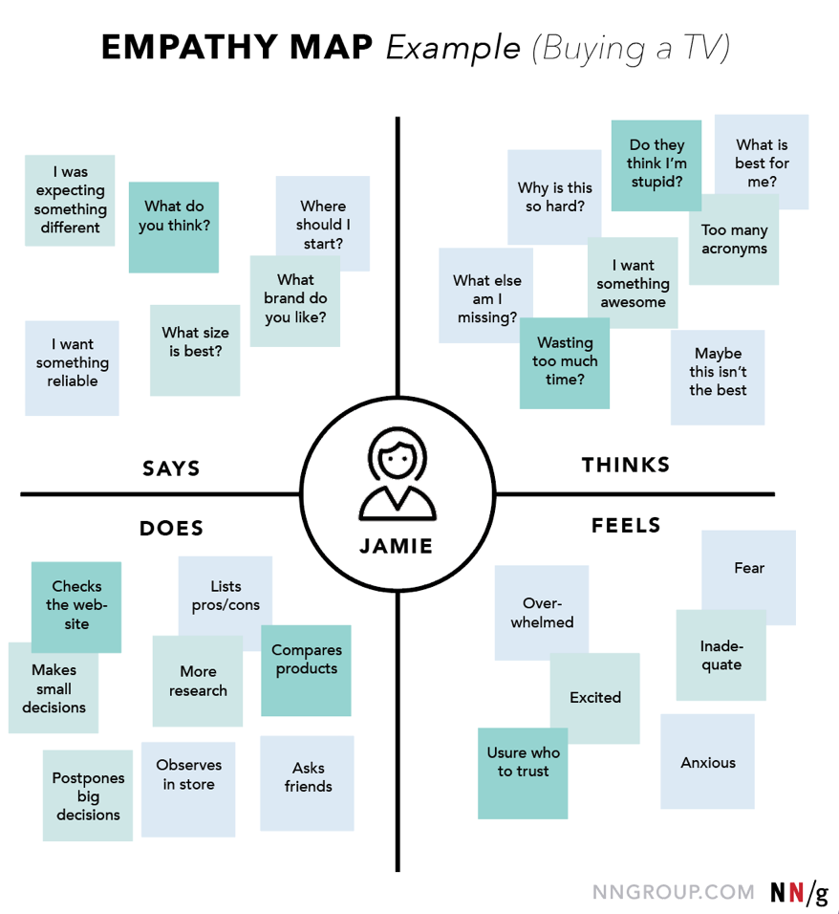
Empathy Mapping: Example

Slide 10
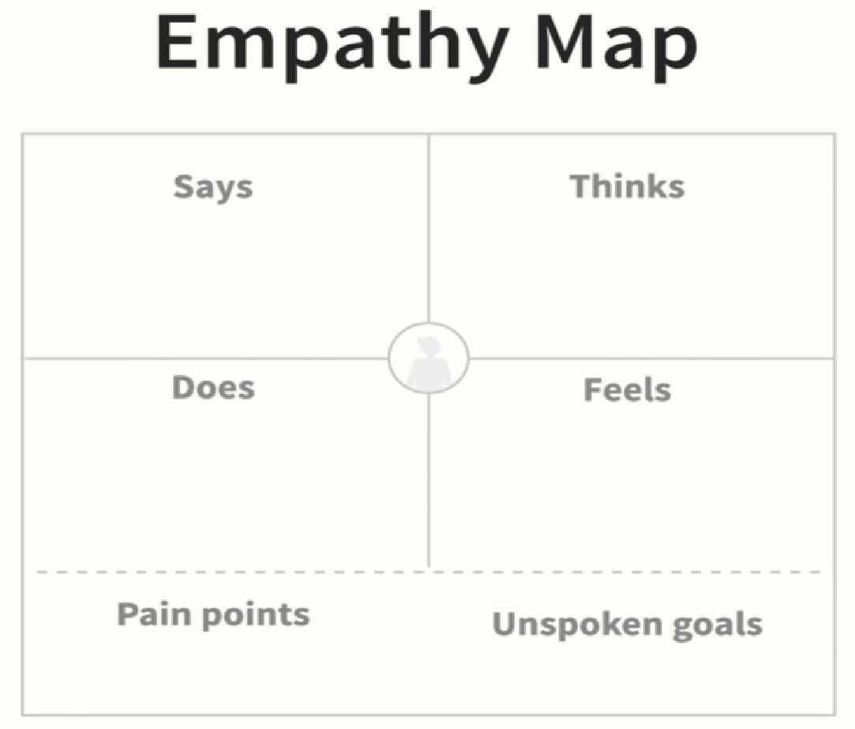
Building an empathy map
How to Build an Empathy Map
Define scope and goals
Gather materials
Collect research
Individually generate sticky notes for each quadrant
Converge to cluster and synthesize
Polish and plan
https://www.nngroup.com/articles/empathy-mapping/
Persona

Slide 11
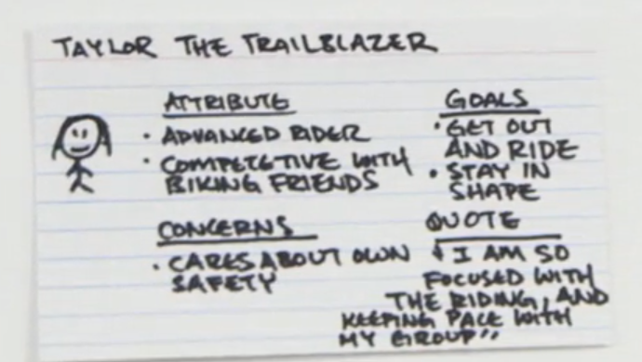
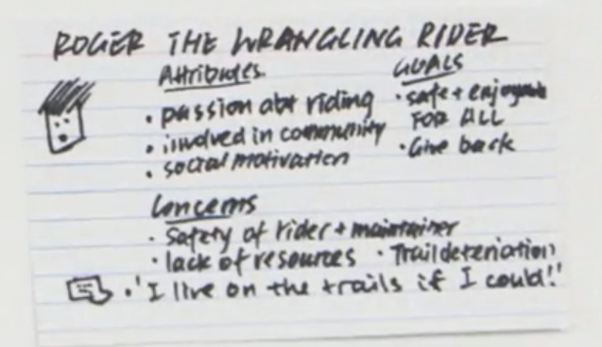
Create a persona
Analyse user attributes, qualities
cluster similar attributes in groups
name each group with a role
make each role personal
name each persona: name, age
Attributes of persona:
what they do in real life?
comfortable with technology?
level of experience in the field?
design implications for each attribute?
Goals
speed, efficiency, accuracy, good presentation
Identify 1-2 personas per feature set

Slide 12

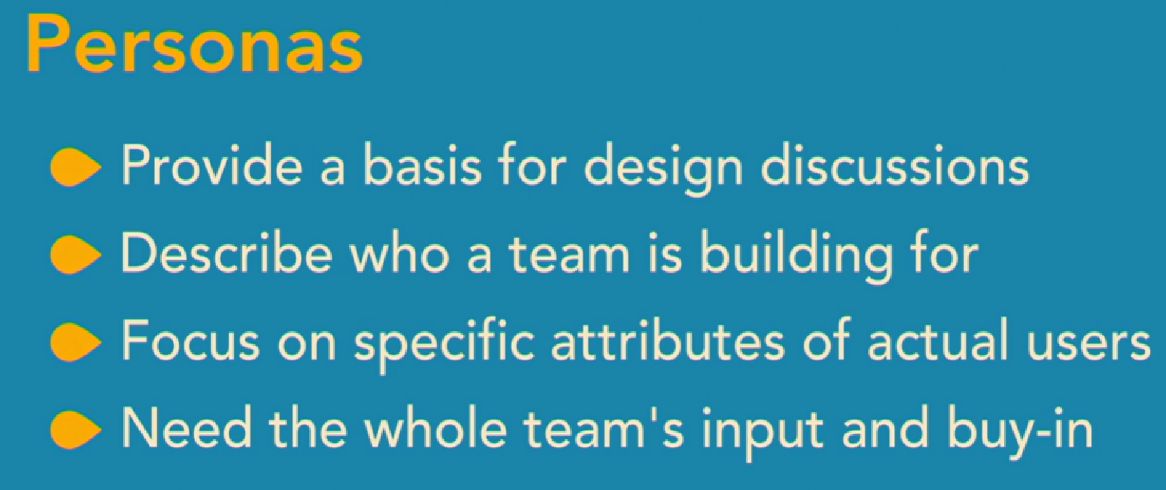
Create a persona (alternative)
Cover the nuts and bolts
Outline each persona’s demographics
Align your personas to reality
Describe what makes them tick
https://www.atlassian.com/software/confluence/templates/persona

Slide 13
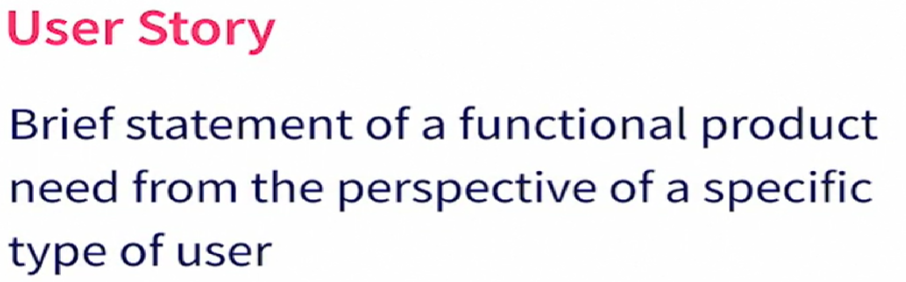
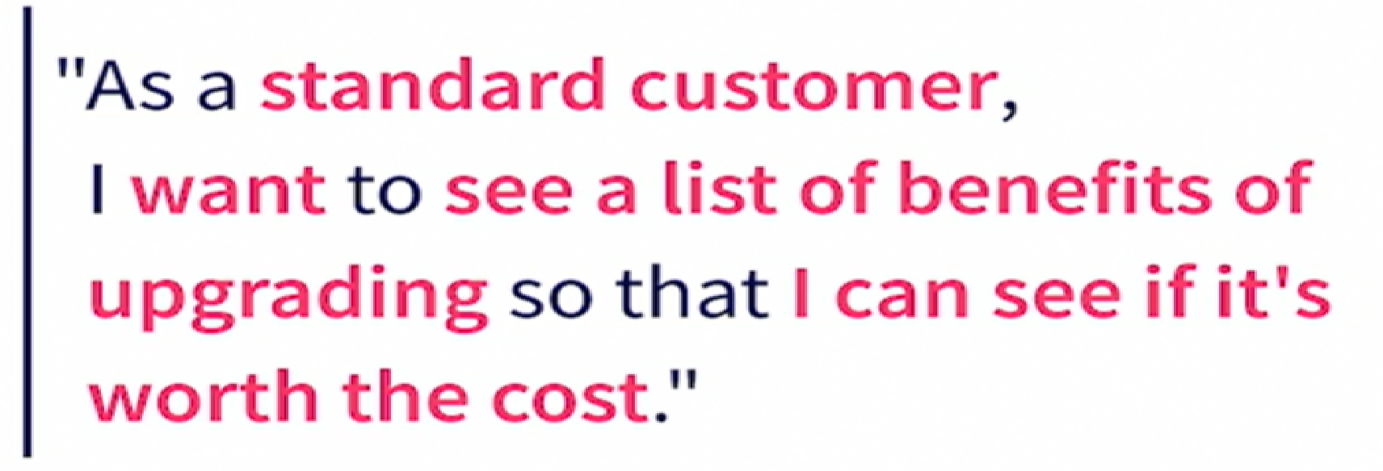
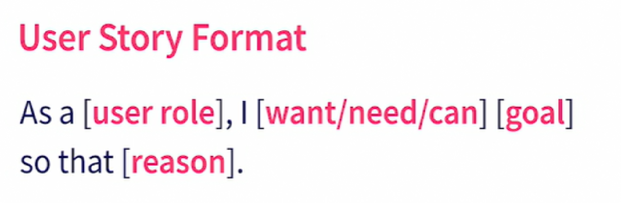
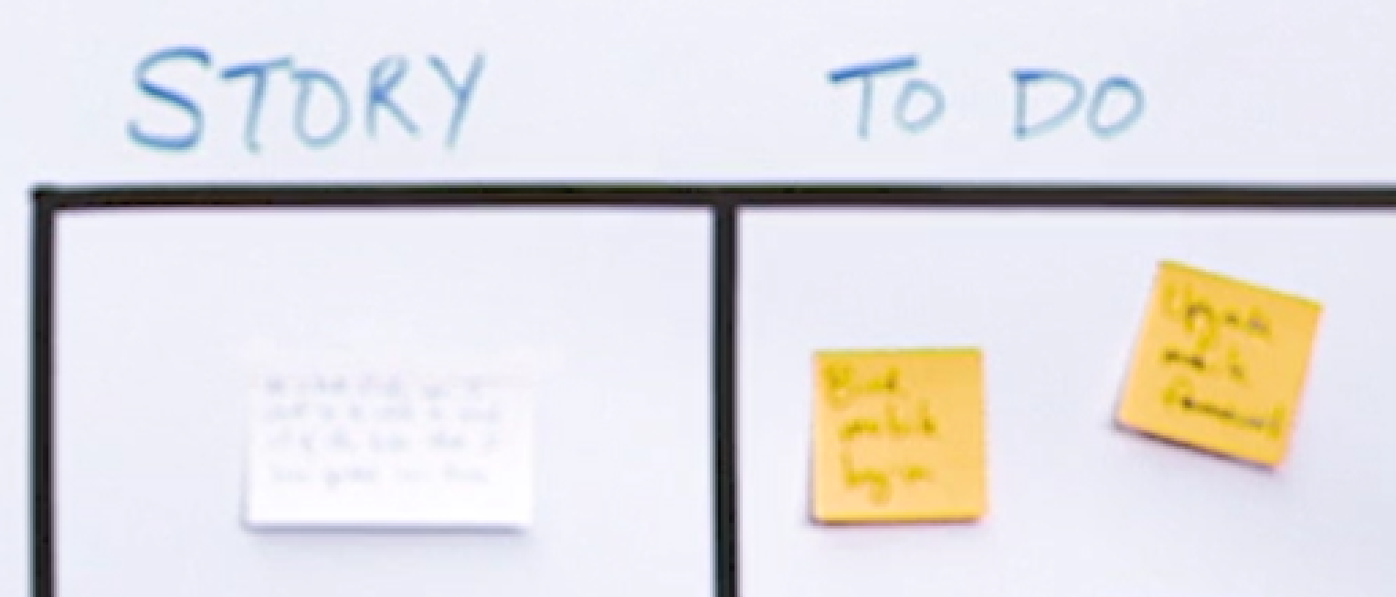
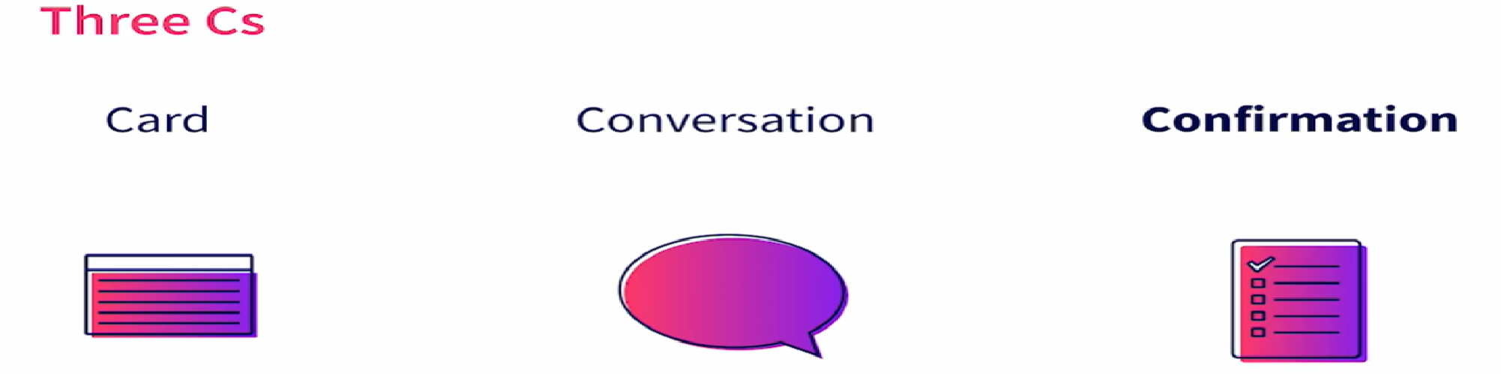
Creating user stories

Slide 14
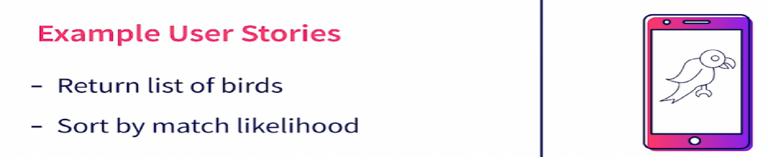
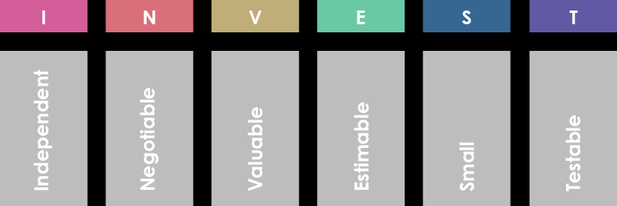
Writing effective user stories
In addition to a standardized format and complete elements, a good user story should also follow the INVEST principles:
Independent;
Negotiable;
Valuable;
Estimable;
Small;
Testable.
https://www.cybermedian.com/how-to-write-effective-user-story-with-invest-principles/

Slide 15
Grouping with themes or epics
What is an agile epic?
An epic is a large body of work that can be broken down into a number of smaller stories, or sometimes called “Issues” in Jira. Epics often encompass multiple teams, on multiple projects, and can even be tracked on multiple boards.
Epic Splitting Method: F.E.E.D.B.A.C.K
F: Flow - Influenced Story
E: Effort - Influenced Story
E: Entry - Influenced Story
D: Data Operations - Influenced Story
B: Business Rules - Influenced Story
A: Alternatives- Influenced Story
C: Complexity- Influenced Story
K: Knowledge- Influenced Story

Slide 16
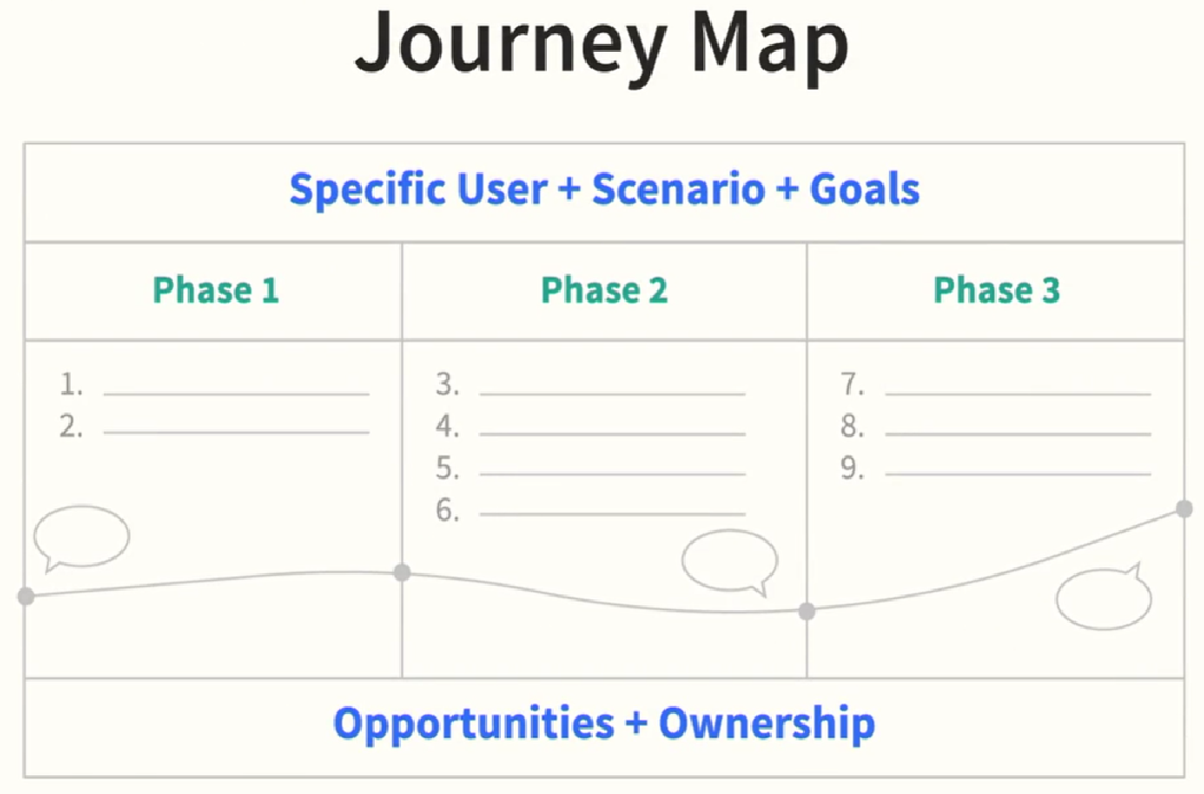
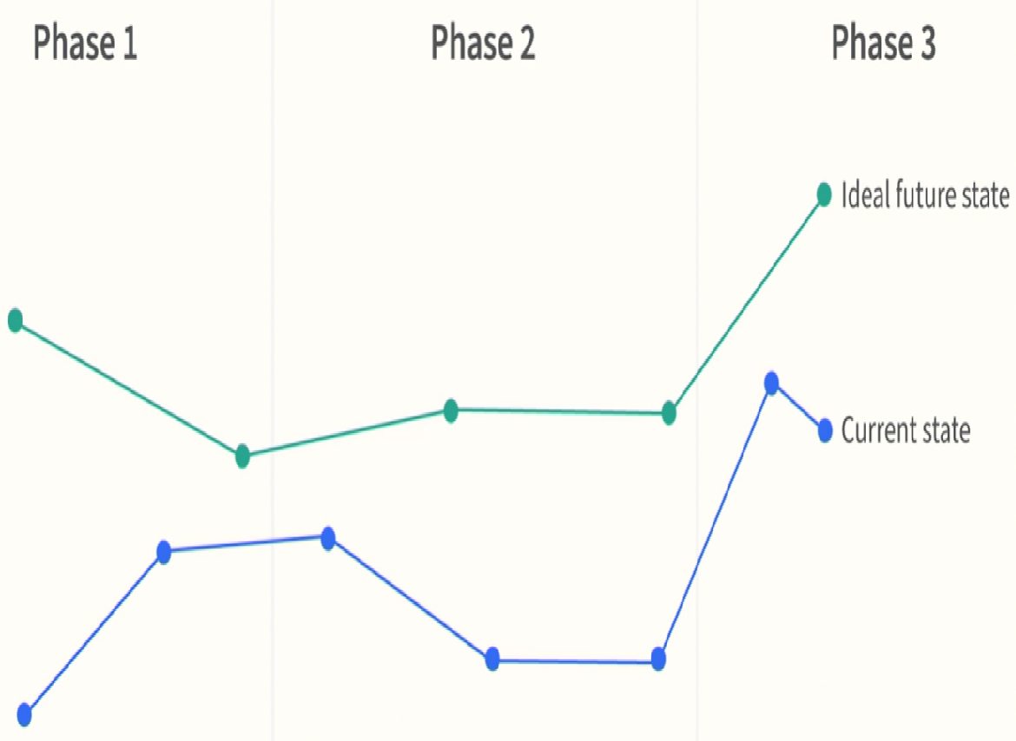
What is a journey map
Notes:
a visual representation of a user’s stats journey through interactions with the system
represented chronologically for each user
2 main types: current state, ideal future state
current state maps:
build shared user focus
highlight opportunities for improve
align teams
gather information from site analytics, sales stats and user observation
help to plan ideal future state maps

Slide 17

Journey map preparation
Defining Goals, Team, and Scope
Set expectations for how the map will be used before starting
Spend time defining the objectives
Start with a small, focused scope
Accept that you can’t (and shouldn’t) map everything
Involve a cross functional team
Build a team of influencers and knowledge holders
Keep your stakeholders engaged
Iterate and don't let perfectionism drag you down
Focus on action and outcomes
https://www.nngroup.com/articles/journey-mapping-tips/

Slide 18
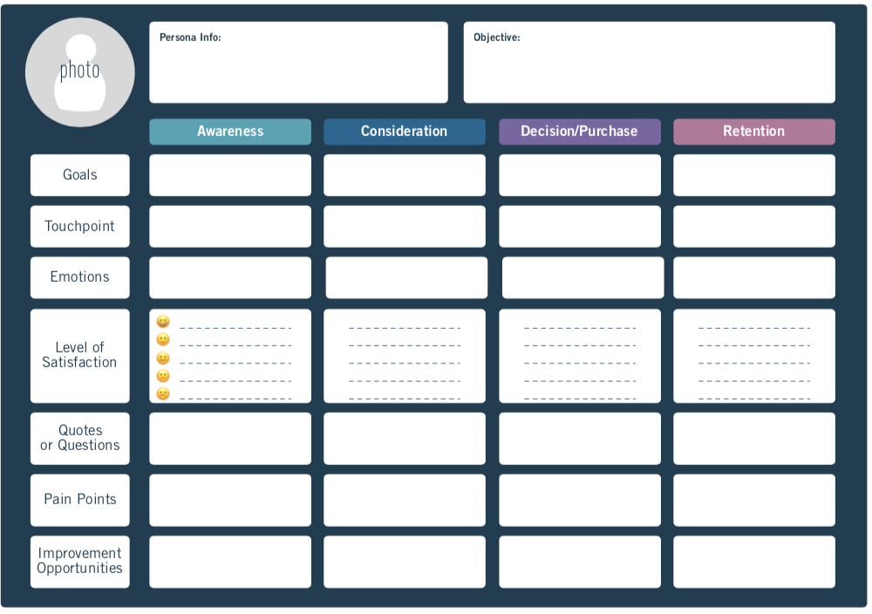
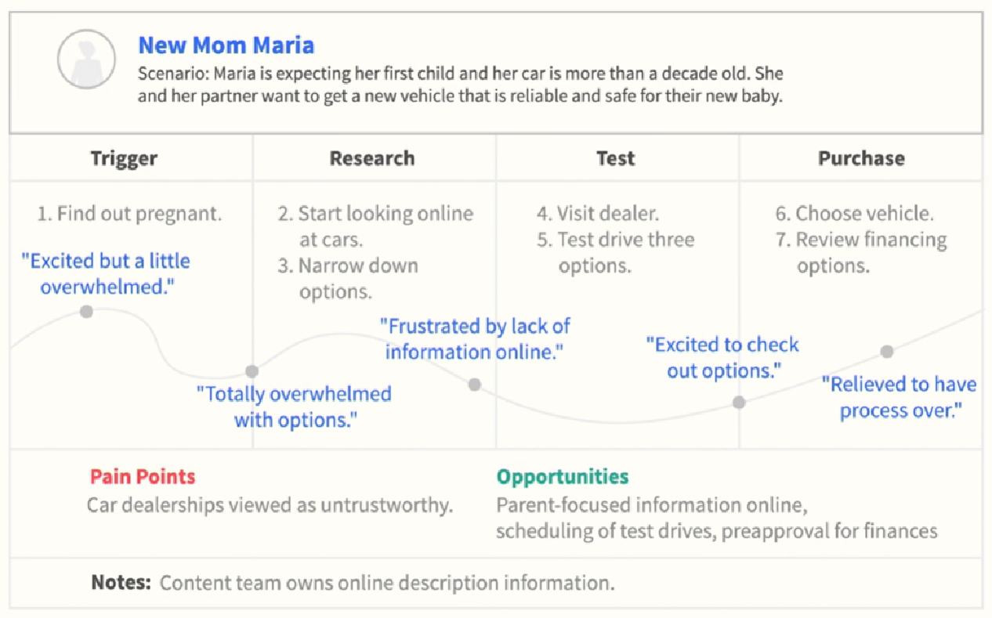
Building a journey map
Example of a Journey map
https://careerfoundry.com/en/blog/ux-design/how-to-make-customer-journey-map-with-template/

Slide 19
Journey map example
https://careerfoundry.com/en/blog/ux-design/how-to-make-customer-journey-map-with-template/

Slide 20
Alternative: Reading material about Design Thinking
Empathy Mapping: The First Step in Design ThinkingLinks to an external site.
How to build a personaLinks to an external site.
How to write user storiesLinks to an external site.
Journey maps 101Links to an external site.,
Tips for getting started with journey mappingLinks to an external site.

Slide 21
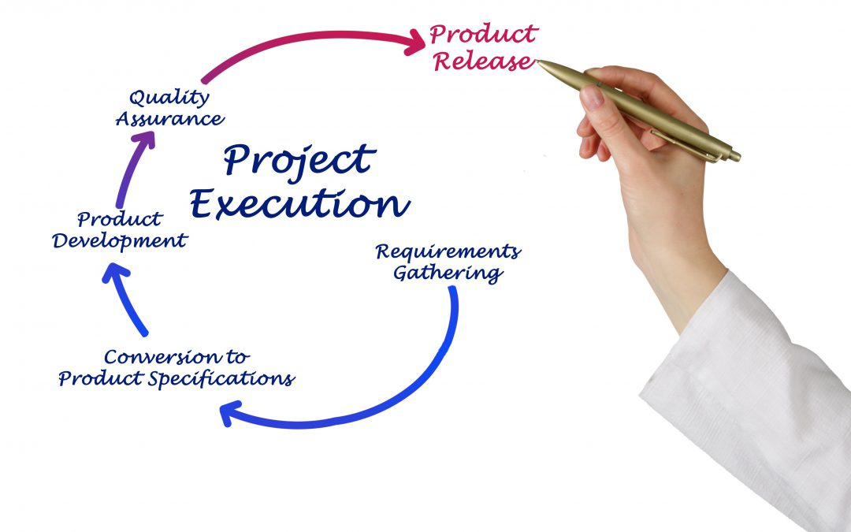
(B) Gathering Requirements

Slide 22
Gathering requirements
Understand the goal
Review the current system
Discover actors and tasks
Interview the client
Work with historical values
Identify exceptions and irregularities

Slide 23
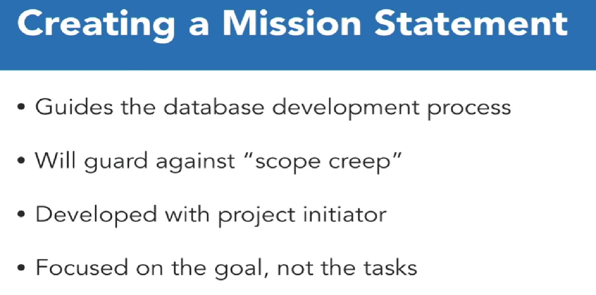
Understand the goal

Slide 24
Review the current system
1. Locating Current Records
Outdated Computer Database
Spreadsheet Files
Paper records in file folders or cabinets
Always keep the mission statement in mind
2. Locating Current Data Export
Summary reports
Transaction logs
Directories
Invoices and Receipts
3. Missing Requirements
What does the system NOT do?
Look for bottlenecks in the process
Is requested summary data difficult to obtain?
Use the current system as a guide, not a model
4. Areas for Growth
Are there any known future requirements?
What reports would be helpful if is available?

Slide 25
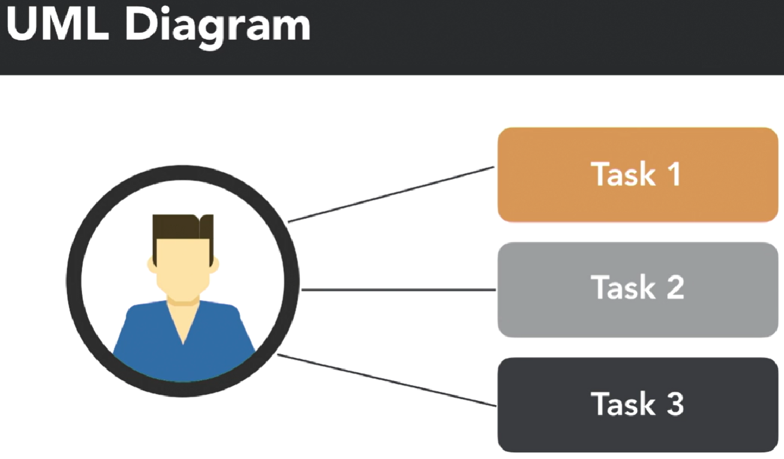
Discover actors and tasks
1. Locating Stakeholders
Identify group of people that interact with the system
User groups are called “Actors”
Actors represent the same position or role
2. Possible Actors for Two Trees
i.e. performs multiple roles, e.g.
Account Executive
Salesperson
Warehouse manager
External Actors include customer and vendor
3. Identifying Actors
Review mission objectives for assistance
Ask “Who would take on this responsibility?”
Only include actors with mission objectives
Notes:
UML diagram: user case diagram

Slide 26
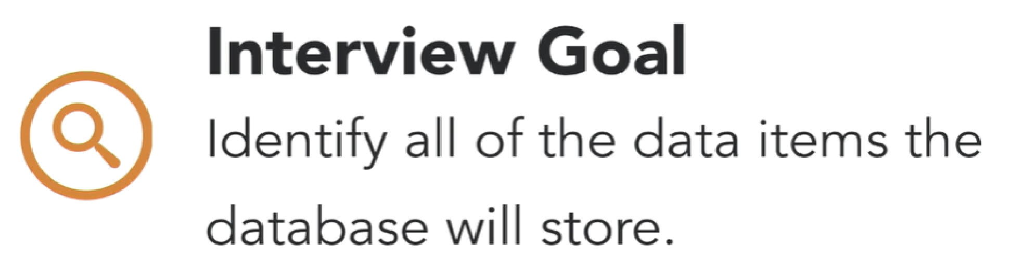
Interview the client
1. Identify Interview Subjects
Locate specific people in each actor group
Seek out the one with the most knowledge or experience
Sometimes known as “subject matter expert”
May also be a single point of contact
2. Conduct an Interview
Come prepared with questions
Keep the interview on topic
Ask open-ended questions for general overviews
Ask closed questions for specific details
3. Business Rules
Formal or informal constraints placed on data
May be written in a company manual
Or “Just known” by everyone in the organization

Slide 27
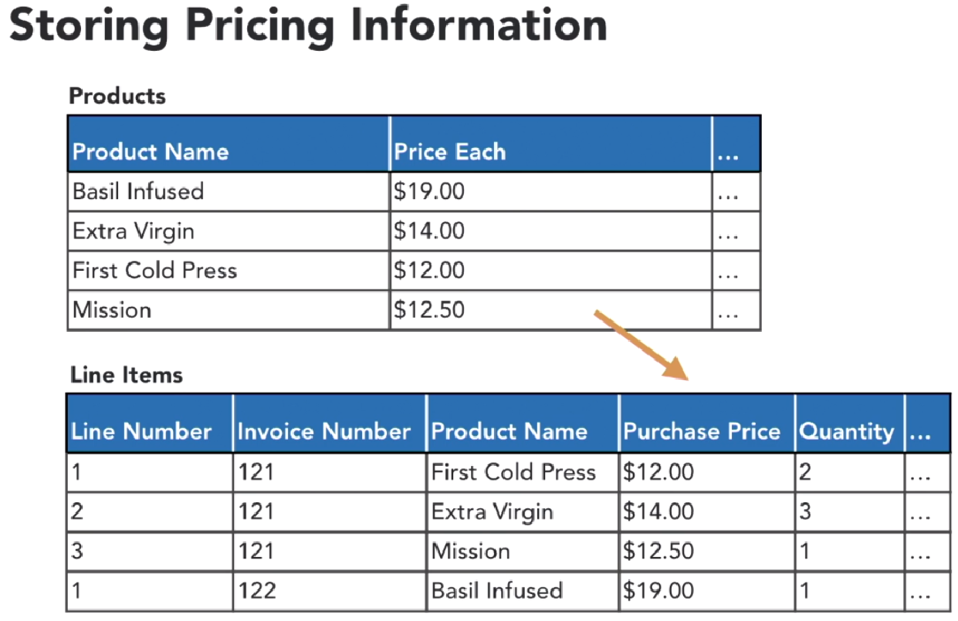
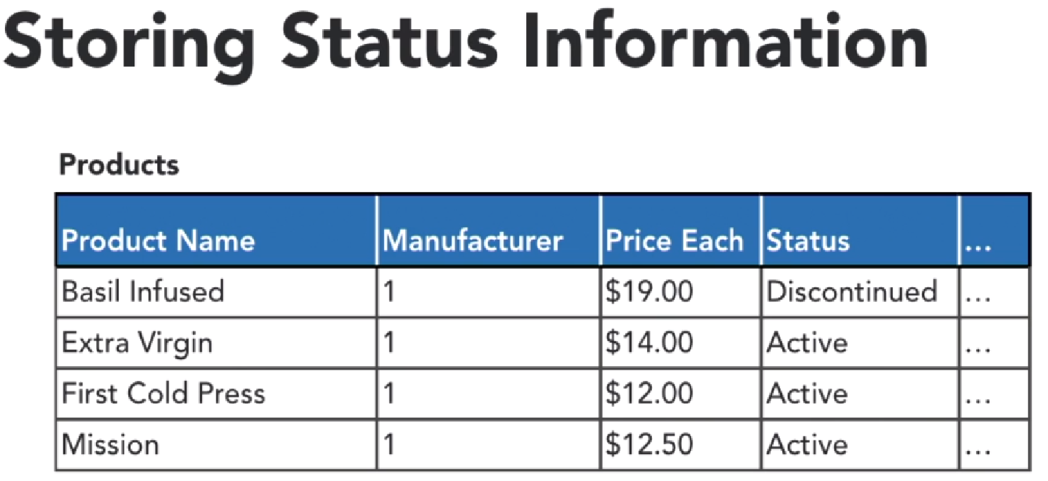
Work with historical values
Case study

Slide 28

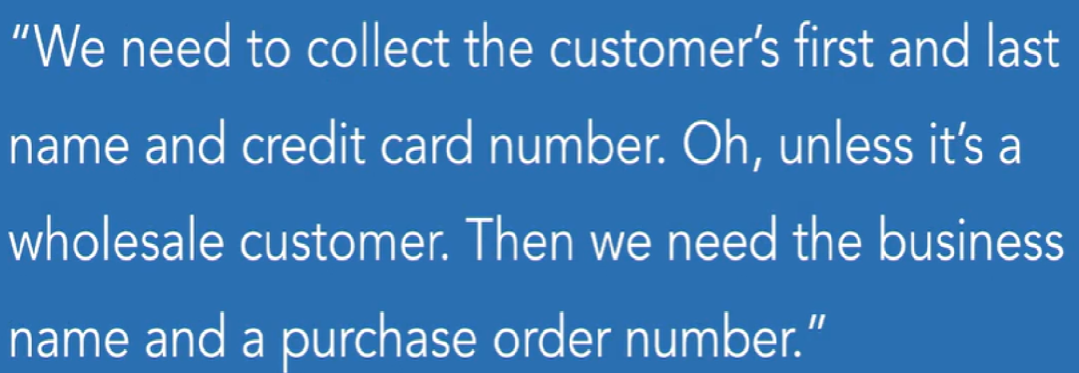
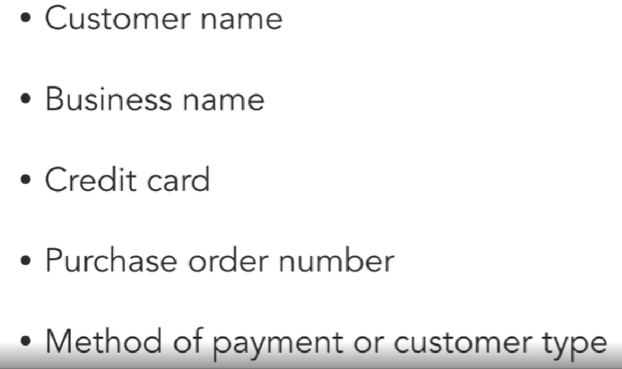
Identify exceptions and irregularities
Notes:
Data items that are exceptions or irregularities (e.g. business name, not just first and last name)

Slide 29
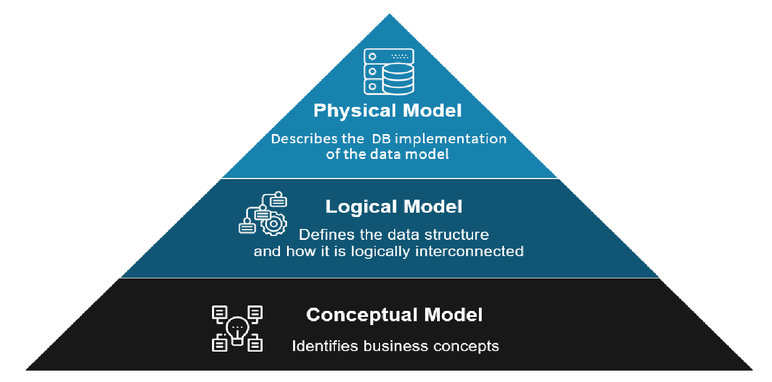
(C) Developing the Conceptual Data Model

Slide 30
Conceptual modelling
Understand entities and tables
Develop relationships
Develop subtypes and supertypes
Utilise lookup tables
Draft the initial data model

Slide 31
Understand entities and tables
1. Building a Data Model
Graphical representation of the database
Your construction blueprint
Visualizes tables and field
Clarifies relationships between tables
2. Understanding Tables
Tables represent collections of entities
They’re made up of records and rows of identical structure
Records store data on places, people, things, or events
3. Identifying Tables
Organize field list into logical groupings
Field will characterize common subjects
Document review and interviews will guide the process
4. Tables Diagram
Each table is represented by a rectangle
Field are listed below the entity name
Entities are connected by lines to represent relationships
Symbols are added to denote the type of relationships

Slide 32
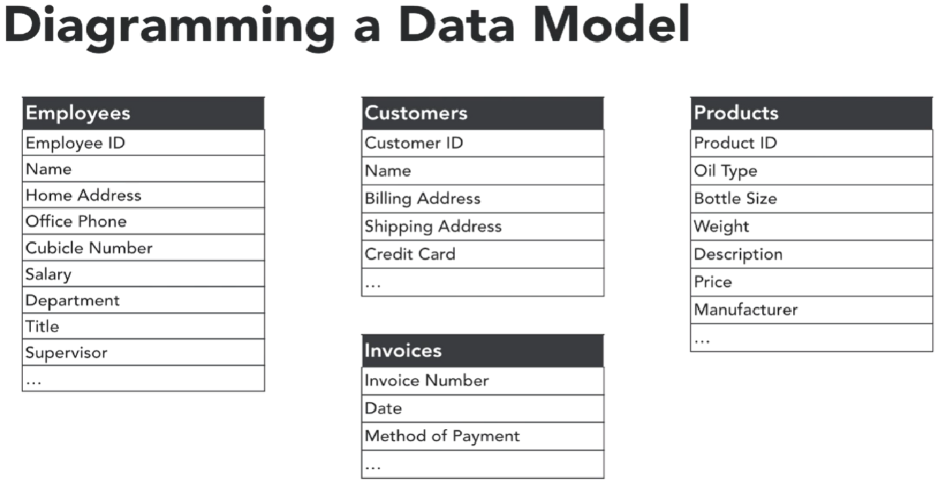
Understand entities and tables (Example)
Case study

Slide 33
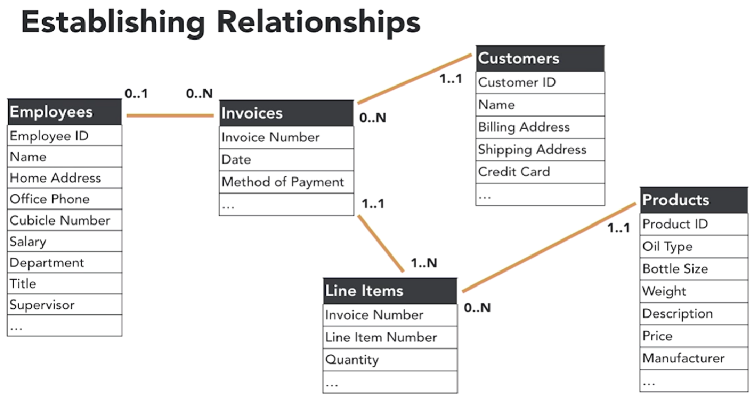

Develop relationships

Slide 34
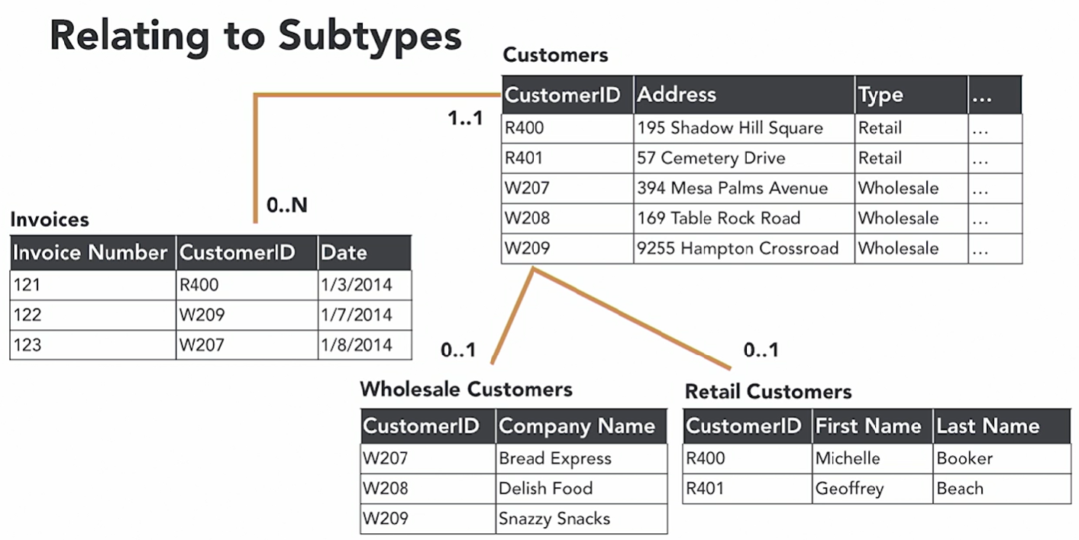

Develop subtypes and supertypes

Slide 35
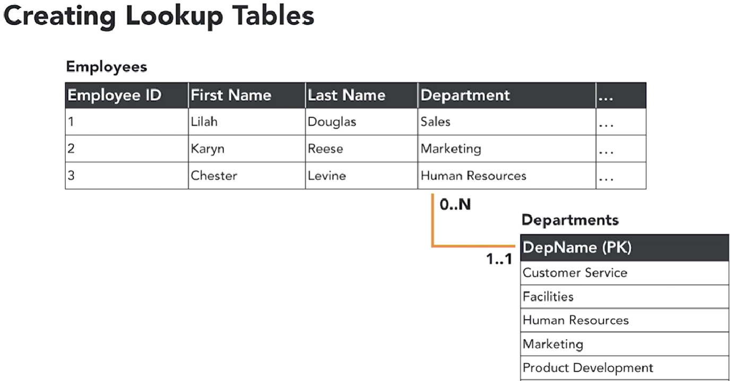

Utilise lookup tables
What are lookup table?
Determined by business rules
Help support data consistency
Create a finite list of acceptance values
Implemented as a drop-down list or combo box

Slide 36
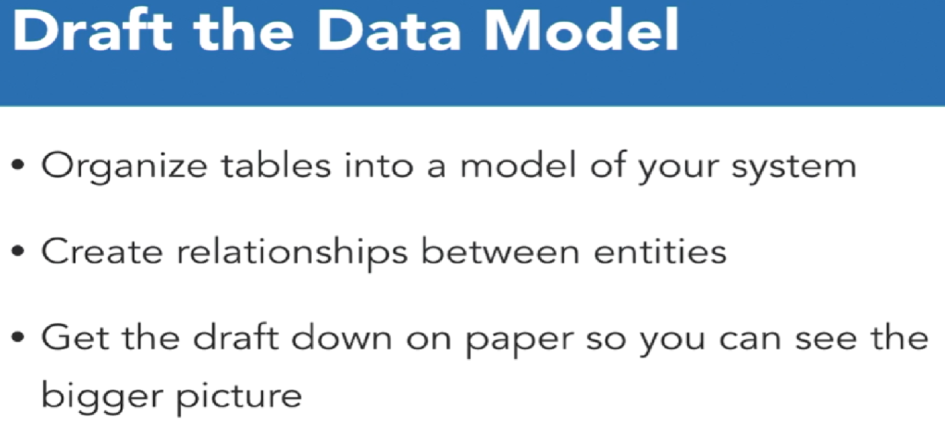
Draft the initial data model

Slide 37
Tutorial & Workshop
See Canvas.

